Slide 1
University of Diyala College of Engineering
Department of Communications Engineering
Electronics II: 3^{ed} Year - 2015/2016 By: Hussein Ahmed Mahmood
Feedback Amplifiers
Feedback Concepts:
A typical feedback connection is shown in Fig.1. The input signal ,V_{S} ,is applied to a mixer network, where it is combined with a feedback signal, Vf. The difference of these signals, Vi, is then the input voltage to the amplifier. A portion of the amplifier output (sampled signal), Vo, is connected to the feedback network (β), which provides a reduced portion of the output as feedback signal to the input mixer network.
There are two basic types of feedback in amplifiers positive feedback and negative feedback. When the feedback energy (voltage or current) is in phase with the input signal and thus aids it, it is called positive feedback. Both amplifier and feedback
network introduce a phase shift of 180°. The result is a 360° phase shift around the loop, When the feedback energy (voltage or current) is out of phase with the input signal and thus opposes it, it is called negative feedback the amplifier introduces a phase shift of 180° into the circuit while the feedback network is so designed that it
introduces no phase shift if the feedback signal is of opposite polarity to the input signal, as shown in Fig.1, negative feedback results. While negative feedback
results in reduced overall voltage gain, a number of improvements are obtained, among them being:

Slide 2
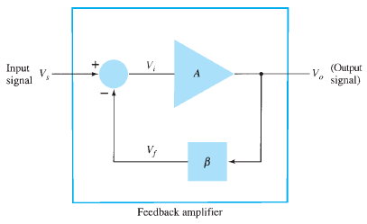
University of Diyala College of Engineering
Department of Communications Engineering
Electronics II: 3^{ed} Year - 2015/2016 By: Hussein Ahmed Mahmood
Higher input impedance.
Lower output impedance.
Better stabilized voltage gain.
Improved frequency response.
Reduced noise.
More linear operation.
Fig.1
Feedback Connection Types:
There are four basic ways of connecting the feedback signal. Both voltage and current can be fed back to the input either in series or parallel. Specifically, there can be:
Voltage-series feedback (Fig.2a).
Voltage-shunt feedback (Fig.2b).
Current-series feedback (Fig.2c).
Current-shunt feedback (Fig.2d).
In the list above, voltage refers to connecting the output voltage as input to the feedback network; current refers to tapping off some output current through the feedback network. Series refers to connecting the feedback signal in series with the input signal voltage; shunt refers to connecting the feedback signal in shunt (parallel) with an input current source.

Slide 3
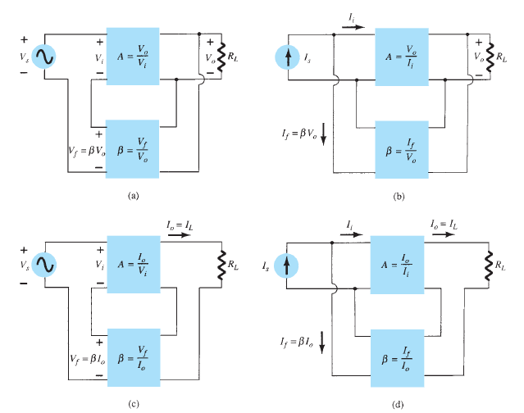
University of Diyala College of Engineering
Department of Communications Engineering
Electronics II: 3^{ed} Year - 2015/2016 By: Hussein Ahmed Mahmood
Generally, series feedback connections tend to increase the input resistance, while shunt feedback connections tend to decrease the input resistance. Voltage feedback tends to decrease the output impedance, while current feedback tends to increase the output impedance.
Fig.2

